Slide 1
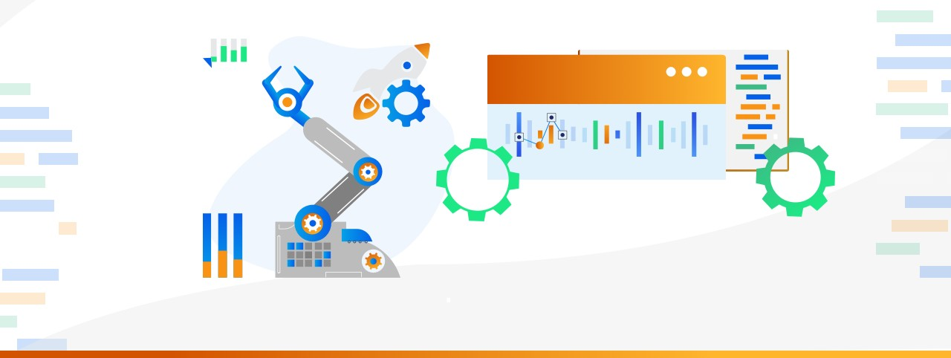

Graduation Project on Manufacturing Downtime Analysis
Presentation by
Kareem Ashraf
Mahmoud Waleed
Mohamed Abdel Rahman
Mohamed Shaaban
Jhad Ibrahem

Slide 2


🚀 Project Idea
Manufacturing downtime leads to reduced productivity and increased operational costs. This project addresses the issue by analyzing production data to identify root causes of downtime, measure efficiency, and highlight performance gaps. What sets this project apart is its dual-layered analysis of both human and non-human error contributions, enabling more targeted and effective improvement strategies.
4/25/25

Slide 3
End Users + Features
👥 Primary User Personas
⚙️ Key Features That Address User Needs
✅ How Features Solve User Problems
Operations Managers – Monitor downtime trends and production performance.
Maintenance Teams – Analyze error types for preventive maintenance.
Production Supervisors – Track efficiency by shift and decisions operator.
Executives – Need high-level insights for strategic.
Downtime Cause Analysis
Shift & Operator Performance Tracking
Batch & Product-Level Efficiency Metrics
Human vs. Non-Human Error Classification
Target Efficiency Monitoring
Interactive Dashboards
Helps managers identify top causes of downtime and improve planning
Supports maintenance teams in detecting patterns in recurring issues
Enables supervisors to compare performance across shifts and operators
Provides executives with clear, visual KPIs for decision-making
4/25/25

Slide 4

🗂️Data Structure
The dataset represents production line data for a soft drink manufacturing process. It was collected during real-time operations and stored in a structured format.
Key Entities and Relationships:
•The main entity is the Batch,
•Linked to Product, Downtime (with reasons and descriptions)
•Time-related data like shift and hour,
•And Operator performance.
⚠️Data Challenges
1. Time Data Was Unclassified by Shifts
2. Downtime Data Was Scattered and Unclear
3. Missing Values in Key Fields
4. No Direct Measure of Efficiency
5. Difficulty in Analyzing Human Performance
4/25/25

Slide 5

👨‍💻 Programming Languages + Frameworks
Python
SQL
• Cleaned and preprocessed time and downtime data for analysis.
• Calculated production duration and classified shifts by start time.
• Mapped and analyzed downtime factors with human error categorization.
• Calculated multiple efficiency metrics, including those excluding human errors.
• Mapped minimum batch time per product and evaluated operator lagging efficiency.
• Calculated average efficiencies per shift and ranked shifts by total downtime.
• Ranked batches per product based on downtime.
• Compared operator performance across batches using LEAD.
• Summarized downtime and efficiency metrics by product and batch using ROLLUP.
4/25/25

Slide 6
📈Operational Efficiency Dashboards
Pages: Overview, Downtime Analysis, Productivity Insights.
Visuals: KPI cards, bar charts, line charts, pie chart, histogram, efficiency gauge.
Selection & Grouping: Elements organized in Selection pane
Filters: Date slicer (8/29/2024–9/3/2024), Shift, Operator, Product, Batch dropdown.
Data Modeling: Fact tables for batches, downtime, and productivity; dimension tables for Date, Operators, Shifts, Products, Flavors.
DAX Measures: Aggregations (e.g., AVERAGE, SUM, COUNTROWS), filtered calculations (e.g., CALCULATE with ALLEXCEPT), percentage calculations (e.g., DIVIDE).
4/25/25

Slide 7

📝Conclusion & Recommendations:
Key Findings
Downtime: 1,398 mins (38 batches)
Causes: Human errors (55.5%), machine issues (44.5%), inventory shortages
Efficiency: 67.08%; only 21% batches hit target
Insights
Operators: Charlie (71%) best; Mac (63%) worst
Shifts: Afternoon/Evening high downtime; Night less efficient
Products: OR-600, CO-2L worst; LE-600 best
Recommendations
Real-time inventory tracking
Targeted operator training
Predictive maintenance
Rebalance shift workloads
Adjust efficiency targets
4/25/25

Slide 8
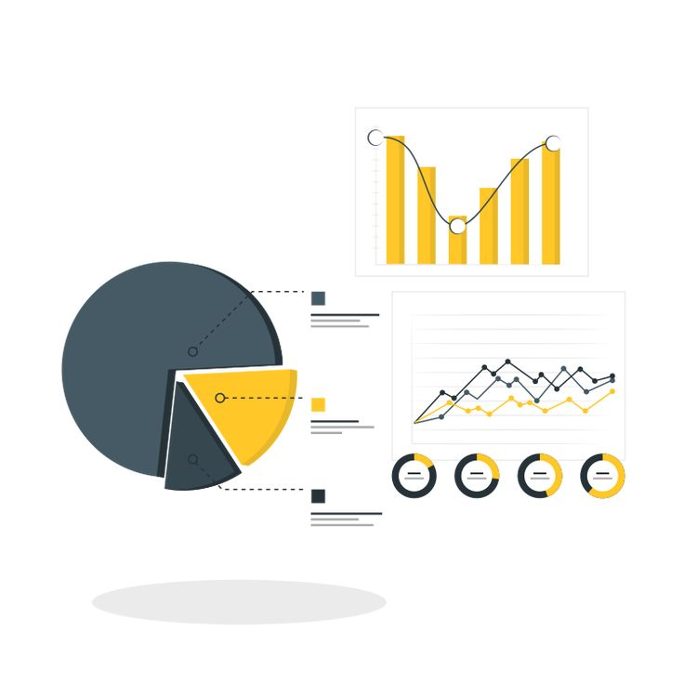
🔧Project Workflow & Tools Used
We received raw production data in multiple Excel files. These were combined and cleaned using Python .Then, SQL was used to analyze trends, efficiency, and downtime patterns. Finally, dashboards were created in Power BI to visualize performance insights interactively.
4/25/25

Slide 9

📦Deliverables
Final presentation and summary report Timeline:
Deliverables:
•First step: Build Data Model, Data Cleaning and Preprocessing
•Second Step: Analysis Questions Phase
•Third step: Visualization Dashboard and Final Presentation
•Fourth step: Documention & Report
•Cleaned and merged dataset
•Python scripts for preprocessing and cleaning
• Forecasting stimulation done by python
•SQL queries used for analysis
•Power BI dashboards visualizing key metrics
Other Outputs:
Final report and presentation
4/25/25

Slide 10

⚙️Project Team + Roles
No | Team Member | Role & Responsibilities
1 | Kareem Ashraf Mohamed | Team Leader: Kept us on track and coordinated everything..
2 | Mahmoud Waleed Mahmoud | Data Cleaner: Made sure our data was accurate and ready to use.
3 | Jhad Ibrahem Ahmed | KPI Expert: Set up the goals and metrics we’d measure.
4 | Mohamed Shaaban Mohamed | Data Checker: Double-checked our work for accuracy.
5 | Mohamed Abdel Rahman Mohamed | Dashboard Creator: Built the visuals to show our results.
4/25/25

Slide 11

4/25/25

